Slide 1
OPERATING SYSTEMS
CPU Scheduling

Slide 2
Basic Concepts
Maximum CPU utilization obtained with multiprogramming
Continuous Cycle :
one process has to wait (I/O)
Operating system takes the CPU away
Give CPU to another process
This pattern continues
CPU–I/O Burst Cycle : Process execution consists of a cycle of CPU execution and I/O wait
Processes in Ready Queue
Schedule
Processor

Slide 3
CPU Scheduler
Selects from among the processes in ready queue, and allocates the CPU to one of them
FIFO queue
Priority queue
Tree
Unordered linked-list
CPU scheduling decisions may take place when a process:
1. Switches from running to waiting state (I/O request)
2. Switches from running to ready state (e.g. when interrupt occurs)
3. Switches from waiting to ready (e.g. at completion of I/O)
Terminates
Scheduling under 1 and 4 is nonpreemptive
All other scheduling is preemptive
Consider access to shared data
Consider preemption while in kernel mode
Consider interrupts occurring during crucial OS activities

Slide 4
Scheduling Criteria
CPU utilization – keep the CPU as busy as possible
Throughput – # of processes that complete their execution per time unit
Turnaround time – amount of time to execute a particular process -- the interval from the time of submission of a process to the time of the completion. -- sum of the periods spent waiting to get into memory, waiting in the ready queue, executing on the CPU, doing I/O
Waiting time – amount of time a process has been waiting in the ready queue
Response time – amount of time it takes from when a request was submitted until the first response is produced, not output (for time-sharing environment)

Slide 5
Scheduling Algorithm Optimization Criteria
Max CPU utilization
Max throughput
Min turnaround time
Min waiting time
Min response time

Slide 6
OPERATING SYSTEMS
CPU Scheduling Algorithms -
First Come First Serve (FCFS)

Slide 7
First-Come, First-Served (FCFS) Scheduling
Ready Queue
Process | Arrival Time | Burst Time
P₁ | 0 | 8
P₂ | 1 | 4
P₃ | 2 | 9
P₄ | 3 | 5
0
P₁(8)
1
P₂(4)
2
P₂(4)
P₃(9)
The Gantt Chart for the schedule is:
P₁
P₂
P₃
P₄
3
P₂(4)
P₃(9)
P₄(5)
0
8
12
21
26
8
P₃(9)
P₄(5)
12
P₄(5)
21
Empty
26
Empty

Slide 8
OPERATING SYSTEMS
CPU Scheduling Algorithms -
Shortest Job First (SJF)

Slide 9
Shortest-Job-First (SJF) Scheduling
Associate with each process the length of its next CPU burst. Use these lengths to schedule the process with the shortest time
Two schemes:
Non-preemptive – once CPU given to the process it cannot be preempted until completes its CPU burst
preemptive – if a new process arrives with CPU burst length less than remaining time of current executing process, preempt. This scheme is known as the Shortest-Remaining-Time-First (SRTF)
SJF is optimal – gives minimum average waiting time for a given set of processes

Slide 10
Example of Shortest-remaining-time-first
Process | Arrival Time | Burst Time
P₁ | 0 | 8
P₂ | 1 | 4
P₃ | 2 | 9
P₄ | 3 | 5
Ready Queue
0
P₁(8)
1
P₁(7)
P₂(4)
Gantt Chart:
P₁(7)
P₂(3)
P₃(9)
2
P₁
P₂
P₄
P₁
P₃
3
P₁(7)
P₂(2)
P₃(9)
P₄(5)
0
1
5
10
17
26
5
P₁(7)
P₃(9)
10
P₃(9)
Empty
Empty
17
26

Slide 11
OPERATING SYSTEMS
CPU Scheduling Algorithms -
Priority Scheduling

Slide 12
Priority Scheduling
A priority number (integer) is associated with each process
The CPU is allocated to the process with the highest priority
(smallest integer ≡ highest priority)
Preemptive
Nonpreemptive
SJF is priority scheduling where priority is the inverse of predicted next CPU burst time
Priority can be defined either internally or externally.
Factors for internal priority assignment:
Time limit, memory requirements, the number or open files etc.
Factors for external priority assignment:
Importance of the process, the type and amount of funds being paid for computer use, department sponsoring works etc.

Slide 13
Example of Priority Scheduling (Preemptive)
Ready Queue
Process | Arrival Time | Burst Time | Priority
P₁ | 0 | 8 | 3
P₂ | 1 | 4 | 1
P₃ | 2 | 9 | 4
P₄ | 3 | 5 | 5
0
P₁(8)
1
P₁(7)
P₂(4)
2
P₁(7)
P₂(3)
P₃(9)
Priority scheduling Gantt Chart
3
P₁(7)
P₂(2)
P₃(9)
P₄(5)
P₁
P₂
P₁
P₃
P₄
P₃(9)
P₄(5)
5
0
1
5
12
21
26
12
P₄(5)
Problem ≡ Starvation – low priority processes may never execute
Solution ≡ Aging – as time progresses increase the priority of the process
21
Empty
26
Empty

Slide 14
OPERATING SYSTEMS
CPU Scheduling Algorithms -
Round Robin (RR)

Slide 15
Round Robin (RR)
Each process gets a small unit of CPU time (time quantum q), usually 10-100 milliseconds. After this time has elapsed, the process is preempted and added to the end of the ready queue.
If there are n processes in the ready queue and the time quantum is q, then each process gets 1/n of the CPU time in chunks of at most q time units at once. No process waits more than (n-1)q time units.
Timer interrupts every quantum to schedule next process
Performance
q large ⇒ FIFO
q small ⇒ q must be large with respect to context switch, otherwise overhead is too high

Slide 16
Example of RR with Time Quantum = 4
Ready Queue:
Process | Arrival Time | Burst Time
P₁ | 0 | 8
P₂ | 1 | 4
P₃ | 2 | 9
P₄ | 3 | 5
0
P₁(8)
1
P₂(4)
2
P₂(4)
P₃(9)
The Gantt chart is:
3
P₂(4)
P₃(9)
P₄(5)
4
P₃(9)
P₄(5)
P₁(4)
P₁
P₂
P₃
P₄
P₁
P₃
P₄
P₃
0
4
8
12
16
20
24
25
26
8
P₄(4)
P₁(4)
12
P₁(4)
P₃(5)
16
P₃(5)
P₄(1)
20
P₄(1)
24
P₃(1)
25
Empty
26
Empty

Slide 17
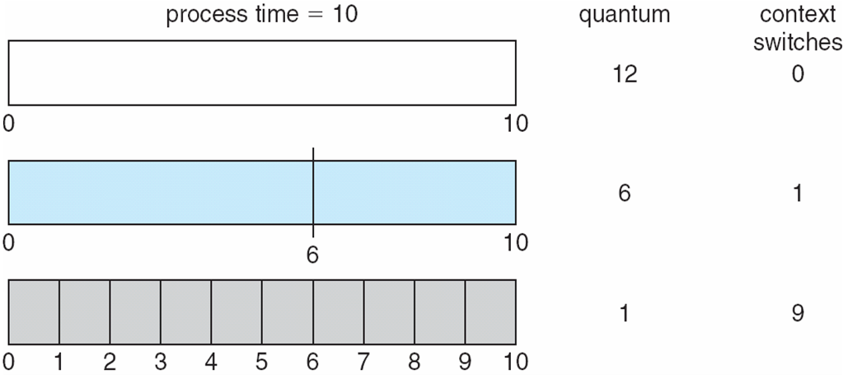
Time Quantum and Context Switch Time

Slide 18
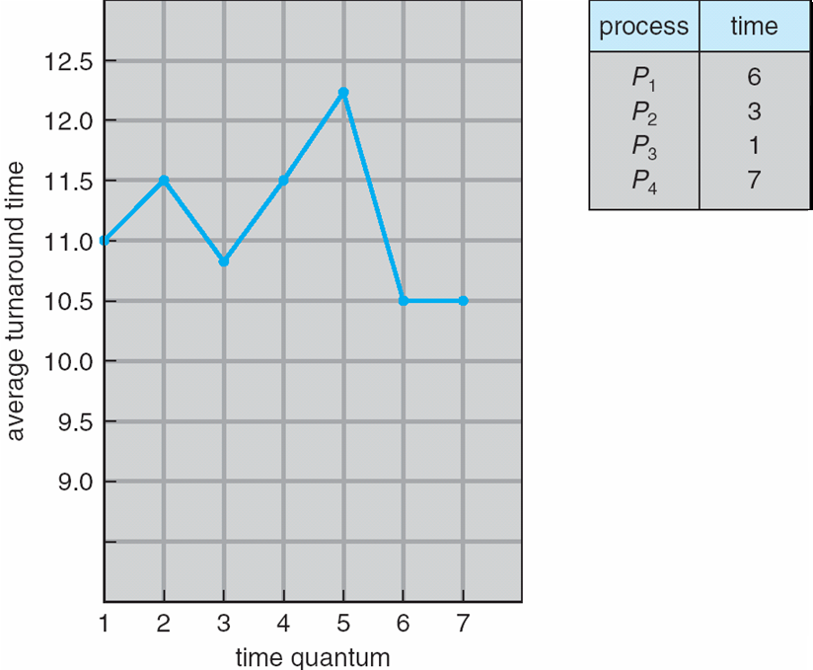
Turnaround Time Varies With The Time Quantum
80% of CPU bursts should be shorter than quantum

Slide 19
OPERATING SYSTEMS
CPU Scheduling -
Multilevel Queue,
Multilevel Feedback Queue

Slide 20
Multilevel Queue
Another class of scheduling algorithm needs- in which processes are classified into different groups, e.g.:
foreground (interactive) processes
background (batch) processes
They have different response time requirements-so different scheduling needs.
Foreground processes may have priority over background processes.
A multilevel queue-scheduling algorithm partitions the ready queue into several separate queues-we can see it in the figure of next slide:-
Each queue has its own scheduling algorithm:
Foreground queue scheduled by – RR algorithm
Background queue scheduled by – FCFS algorithm
Scheduling must be done between the queues:
Fixed priority preemptive scheduling; (i.e., serve all from foreground then from background). Possibility of starvation.
Time slice – each queue gets a certain amount of CPU time which it can schedule amongst its processes; i.e., foreground queue can be given 80% of the CPU time for RR-scheduling among its processes, while 20% to background in FCFS manner.

Slide 21
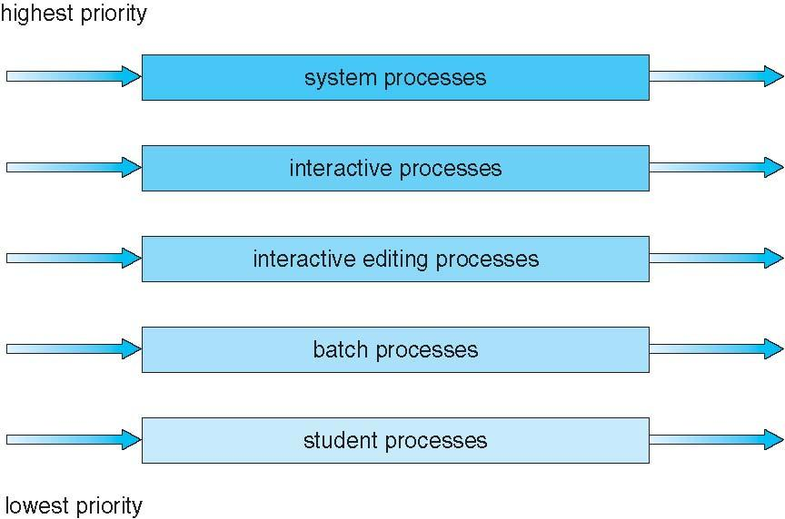
Multilevel Queue Scheduling
Notes:
Partitions ready queue into several queues.

Slide 22
Multilevel Feedback Queue scheduling
Multilevel Feedback Queue scheduling, allows a process to move between queues.
If a process uses too much CPU time, it will be moved to a lower priority queue.
Similarly, a process that waits too long in a lower-priority queue may me moved to a higher-priority queue.
Multilevel-feedback-queue scheduler defined by the following parameters:
number of queues
scheduling algorithms for each queue
method used to determine when to upgrade a process
method used to determine when to demote a process
method used to determine which queue a process will enter when that process needs service

Slide 23
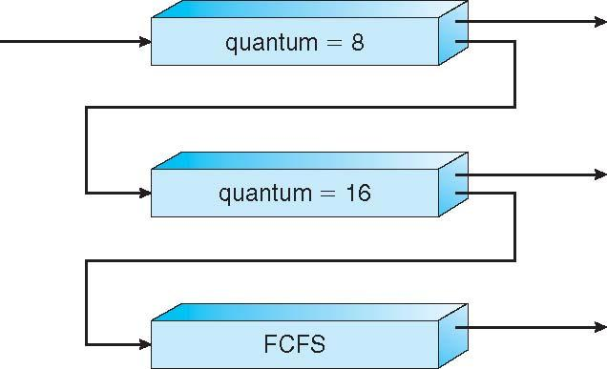
Example of Multilevel Feedback Queue
Three queues: (can see the figure in next slide)
Q₀ – RR with time quantum 8 milliseconds
Q₁ – RR time quantum 16 milliseconds
Q₂ – FCFS
Scheduling
A new job enters queue Q₀ which is served for RR
When it gains CPU, job receives 8 milliseconds
If it does not finish in 8 milliseconds, job is moved to queue Q₁
At Q₁ job is again served RR and receives 16 additional milliseconds
If it still does not complete, it is preempted and moved to queue Q₂

Slide 24
Example of Multilevel Feedback Queue
Problem 1:
Processes | Burst Time
P1 | 12
P2 | 8
P3 | 18
Queue 1 (Priority 1): Round-robin (quantum=4)
Queue 2 (Priority 2): Round-robin (quantum=8)
Queue 0 (Priority 0): Round-robin (quantum=2)
0:
Empty
0:
Empty
0:
P1 (12)
P2 (8)
P3 (18)
2:
P1 (10)
P1 (6)
10:
2:
P2 (8)
P3 (18)
4:
P1 (10)
P2 (6)
P1 (6)
P2 (2)
14:
4:
P3 (18)
6:
P2 (6)
P3 (16)
P2 (2)
P3 (12)
18:
6:
Empty
10:
P3 (16)
P3 (12)
24:
18:
Empty
P3 (4)
34:
38:
Empty
Gantt Chart:
CPU:
P1
P2
P3
P1
P2
P3
P1
P2
P3
P3
0
2
4
6
10
14
18
24
26
34
38

Slide 25
Example of Multilevel Feedback Queue
Problem 1:
Processes | Burst Time
P1 | 12
P2 | 8
P3 | 18
Gantt Chart:
CPU:
P1
P2
P3
P1
P2
P3
P1
P2
P3
P3
0
2
4
6
10
14
18
24
26
34
38
Waiting Time:
P1=(0-0)+(6-2)+(18-10)=12
P2=(2-0)+(10-4)+(24-14)=18
P3=(4-0)+(14-6)+(26-18)+(34-34)=20
Avg=(12+18+20)/3=16.67
Response Time:
P1=(0-0)=0
P2=(2-0)=2
P3=(4-0)=4
Avg=(0+2+4)/3=2
Turnaround Time:
P1=(24-0)=24
P2=(26-0)=26
P3=(38-0)=38
Avg=(24+26+38)/3=29.33

Slide 26
Example of Multilevel Feedback Queue
Problem 2:
Processes | Burst Time | Arrival Time | I/O Time
P1 | 12 | 0 | 6 [2s I/O operation after total 4s of CPU allocation & 4s I/O operation after total 9s of CPU allocation]
P2 | 8 | 1 | 1 [1s I/O operation after total 5s of CPU allocation]
P3 | 18 | 4 | N/A
P4 | 7 | 20 | 5 [5s I/O operation after total 4s of CPU allocation]
Queue 0 (Priority 0): Round-robin (quantum=2)
Queue 1 (Priority 1): Round-robin (quantum=4)
Queue 2 (Priority 2): Round-robin (quantum=8)
I/O Queue
0:
P1 (12)
13:
Empty
0:
Empty
19:
P2 (1)
0:
Empty
0:
Empty
22:
P1 (I/O: 4)
1:
P2 (8)
20:
P4 (7)
2:
P1 (10)
24:
P4 (5)
19:
P3 (12)
8:
P1 (I/O: 2)
22:
Empty
2:
Empty
22:
Empty
4:
P1 (10)
P2 (6)
25:
Empty
30:
Empty
8:
Empty
27:
P4 (I/O: 5)
P3 (18)
P1 (3)
Promoted 1 level after I/O Operation
P2 (6)
P3 (16)
P1 (1)
P3 (4)
P2 (I/O: 1)
4:
26:
6:
29:
38:
11:
27:
Empty
4:
Empty
27:
Empty
8:
P3 (16)
29:
Empty
41:
Empty
11:
Empty
Promoted 1 level after I/O Operation
Promoted 1 level after I/O Operation
10:
P1 (4)
32:
P4 (3)
13:
P3 (16)
P1 (6)
40:
P4 (1)
I/O Operations Gantt Chart
11:
Empty
38:
Empty
15:
P3 (16)
P1 (6)
P2 (1)
40:
Empty
P1
IDLE
P2
IDLE
P1
IDLE
P4
Promoted 1 level after I/O Operation
12:
P2 (3)
15:
P1 (6)
P2 (1)
8
10
11
12
22
26
27
32
Gantt Chart:
CPU:
I/O
I/O
I/O
I/O
P1
P2
P3
P1
P2
P1
P2
P3
P1
P4
P2
P4
P1
P1
P3
P4
P4
P3
0
2
4
6
8
11
13
15
19
22
24
25
27
29
30
38
40
41
45

Slide 27
Example of Multilevel Feedback Queue
Problem 2:
Processes | Burst Time | Arrival Time | I/O Time
P1 | 12 | 0 | 6 [2s I/O operation after total 4s of CPU allocation & 4s I/O operation after total 9s of CPU allocation]
P2 | 8 | 1 | 1 [1s I/O operation after total 5s of CPU allocation]
P3 | 18 | 4 | N/A
P4 | 7 | 20 | 5 [5s I/O operation after total 4s of CPU allocation]
Gantt Chart:
CPU:
I/O Operations Gantt Chart
I/O
I/O
I/O
I/O
P1
IDLE
P2
IDLE
P1
IDLE
P4
P1
P2
P3
P1
P2
P1
P2
P3
P1
P4
P2
P4
P1
P1
P3
P4
P4
P3
0
2
4
6
8
11
13
15
19
22
24
25
27
29
30
38
40
41
45
8
10
11
12
22
26
27
32
Waiting Time:
P1=(0-0)+(6-2)+(11-10)+(19-13)+(27-26)+(29-29)
=12
P2=(2-1)+(8-4)+(13-12)+(24-15)=15
P3=(4-4)+(15-6)+(30-19)+(41-38)=23
P4=(22-20)+(25-24)+(38-32)+(40-40)=9
Avg=(12+15+23+9)/4=14.75
Response Time:
P1=(0-0)=0
P2=(2-1)=1
P3=(4-4)=0
P4=(22-20)=2
Avg=(0+1+0+2)/4=0.75
Turnaround Time:
P1=(30-0)=30
P2=(25-1)=24
P3=(45-4)=41
P4=(41-20)=21
Avg=(30+24+41+21)/4=29

